Slide 1


Slide 2
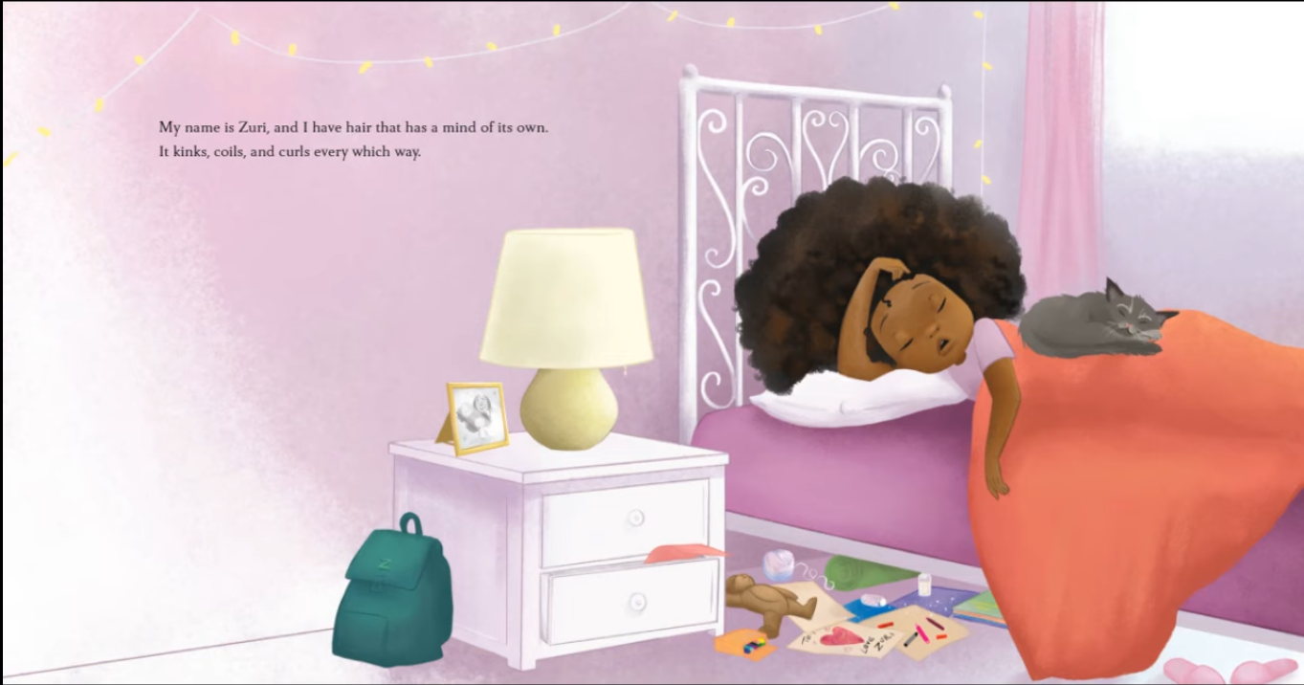
1 Zuri has beautiful curly hair. 2

Slide 3
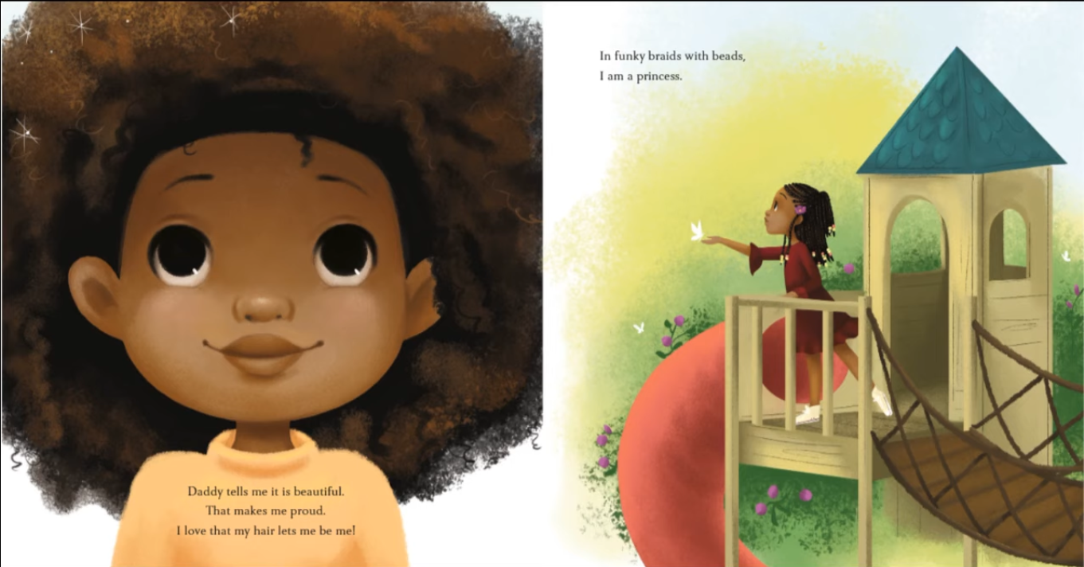
3 Zuri’s hair makes her feel proud. 4

Slide 4
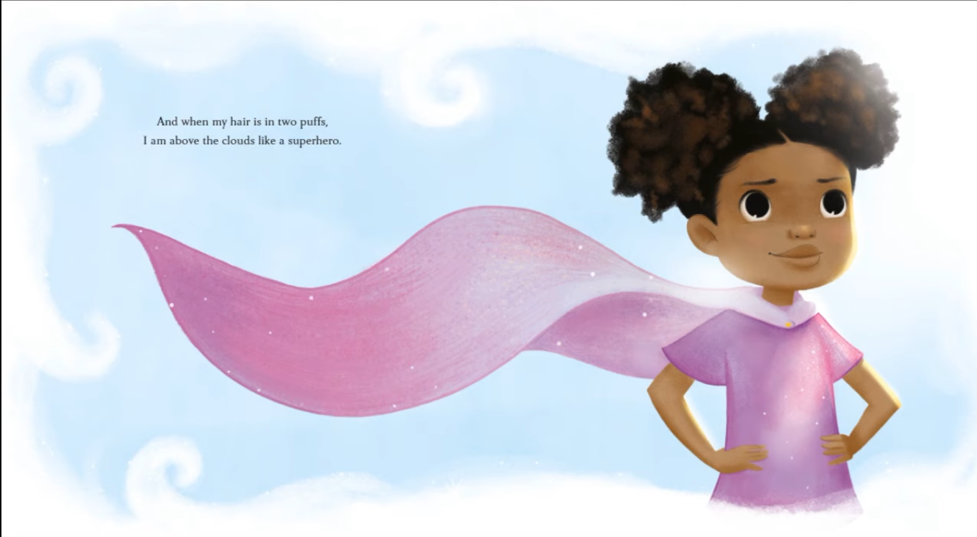
5 Zuri pretends to be a superhero with her hair in puffs. 6

Slide 5
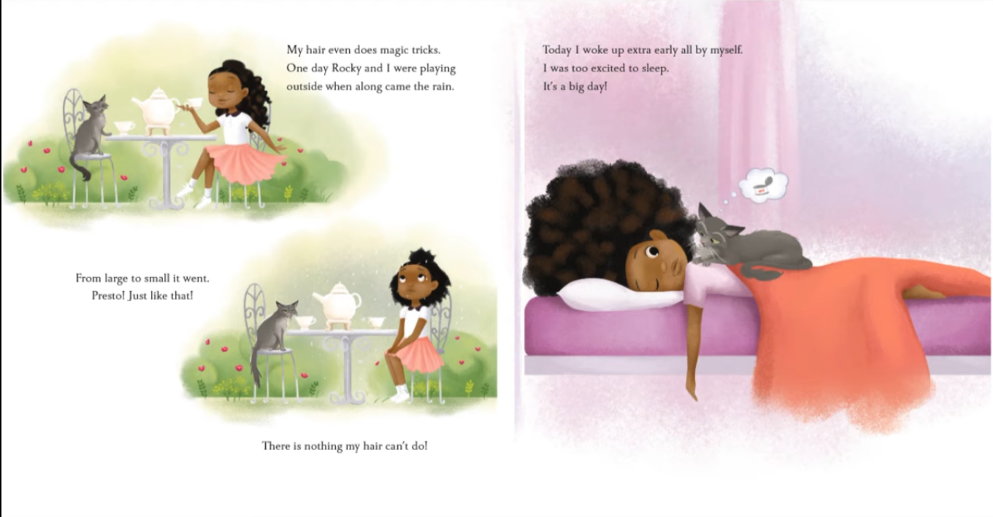
7 Today was a special day. 8

Slide 6
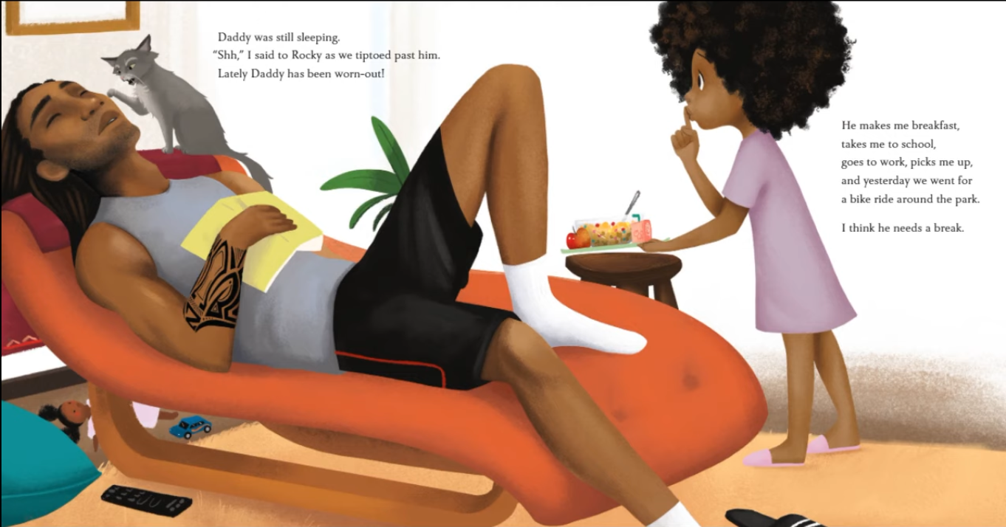
9 Zuri and her kitty tried not to wake up Daddy. 10

Slide 7
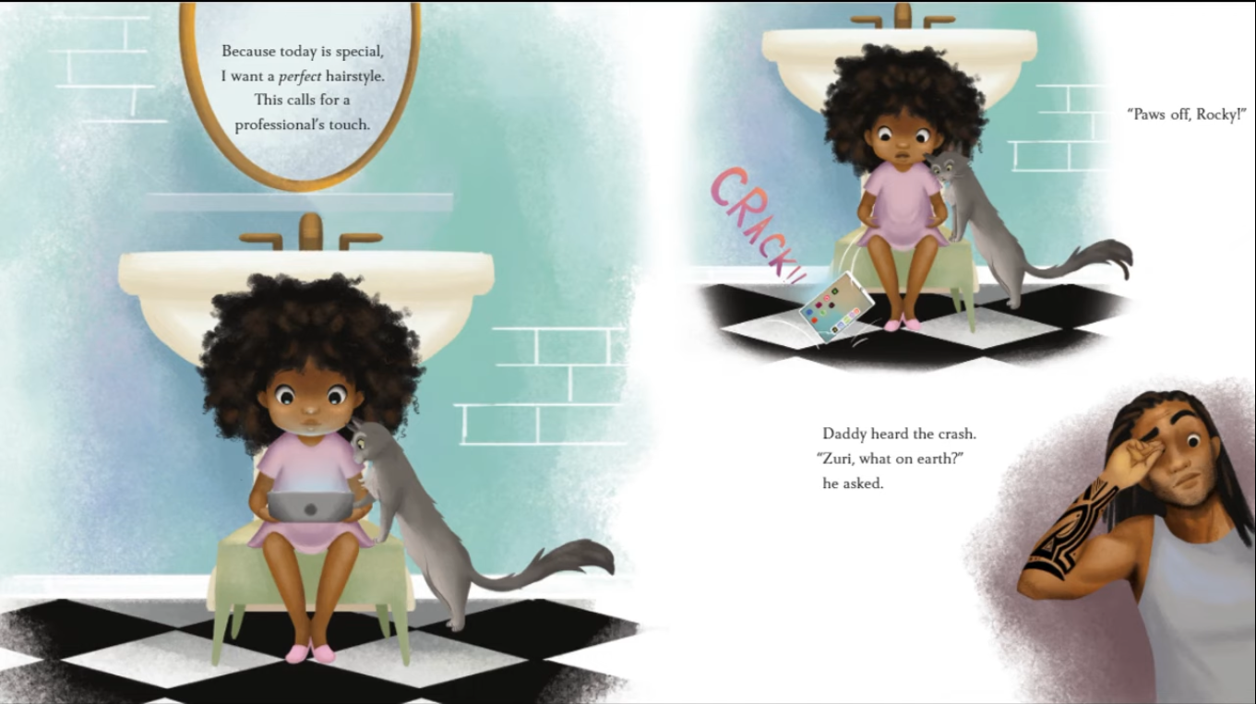
11 Zuri looked at hairstyles on her tablet. 12

Slide 8
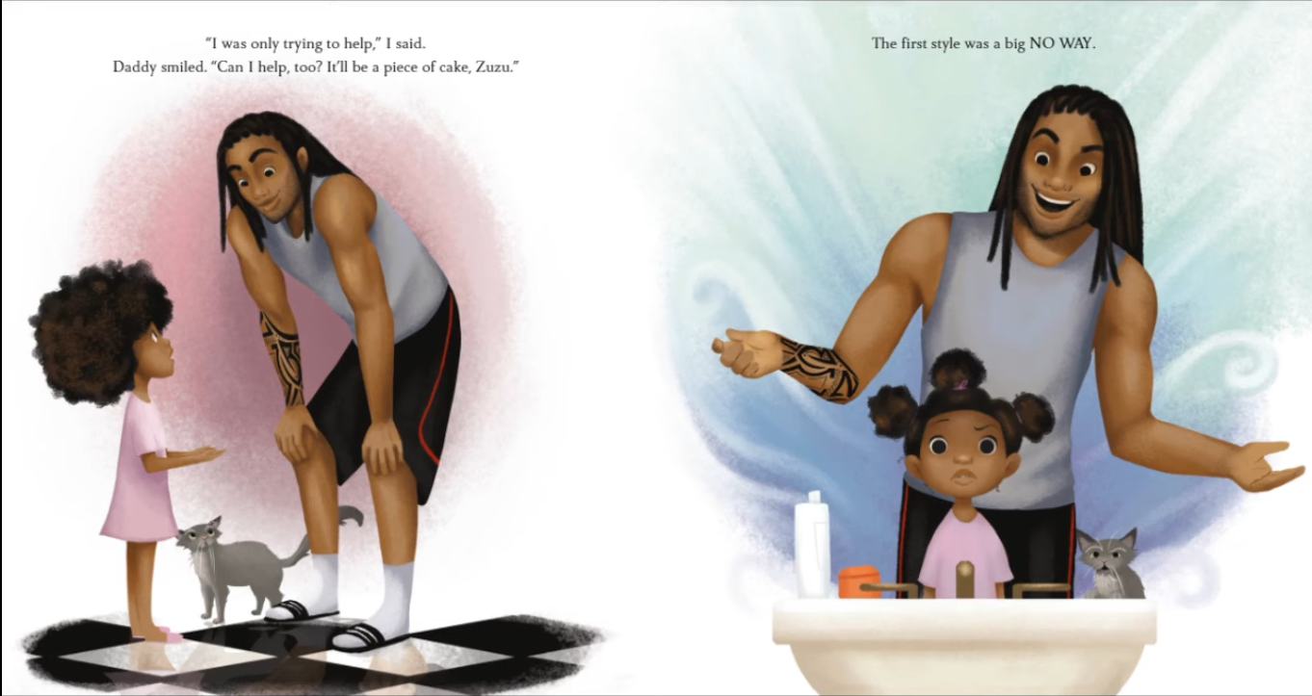
13 Daddy tried to help Zuri fix her hair. 14

Slide 9
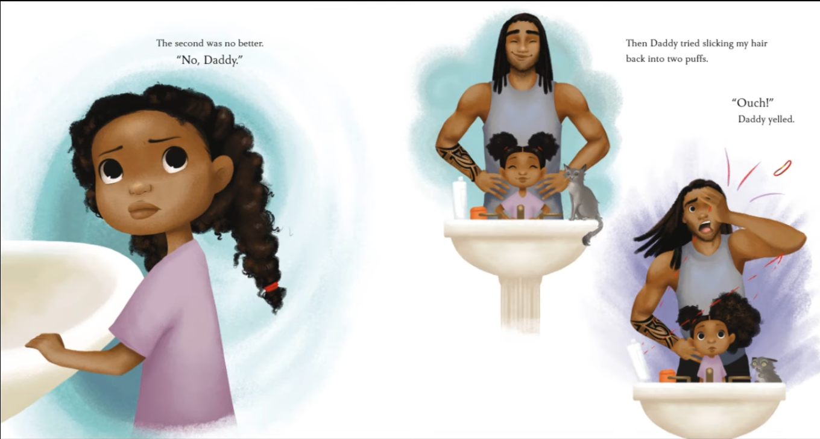
15 Daddy kept trying different hairstyles. 16

Slide 10
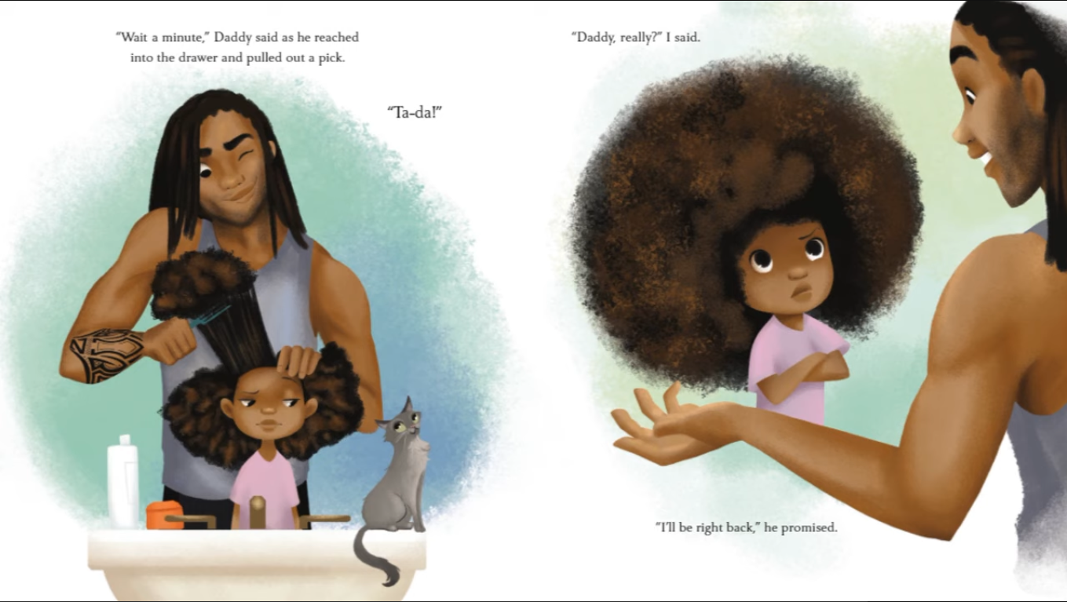
17 Daddy brushed Zuri’s hair. 18

Slide 11
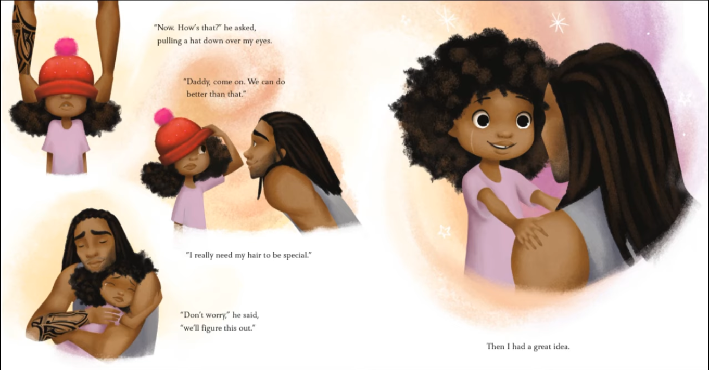
19 Daddy tried to fix Zuri’s hair with a hat. 20

Slide 12
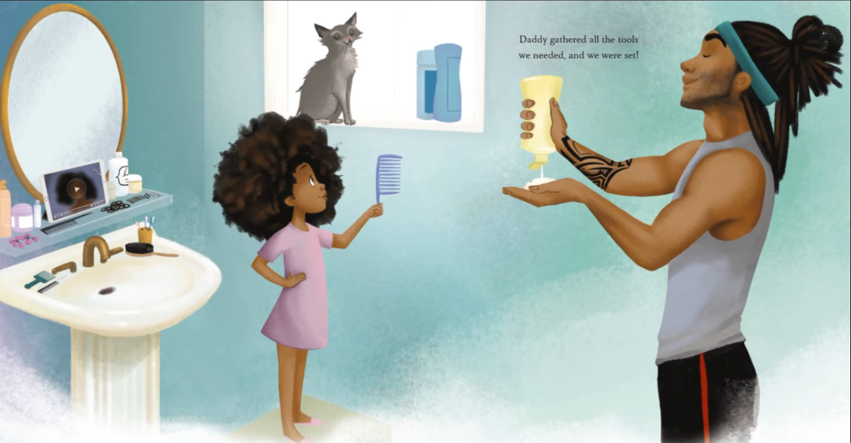
21 Daddy got ready to fix Zuri’s hair. 22

Slide 13
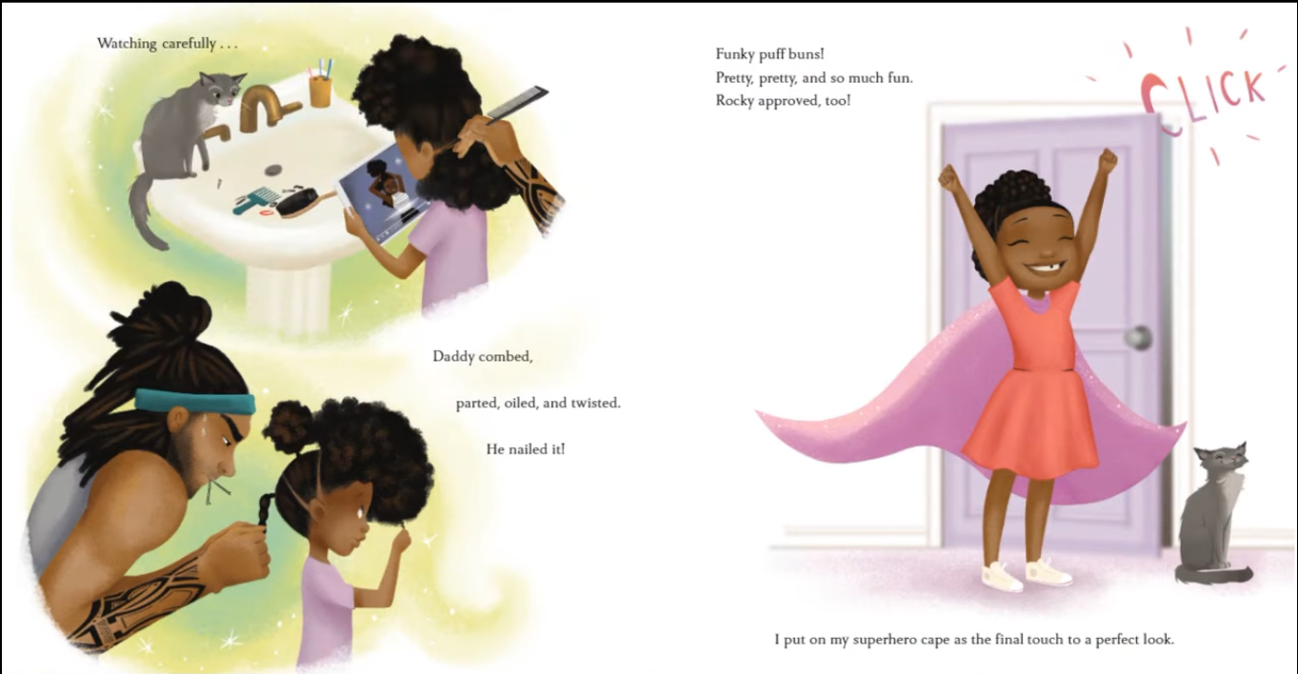
23 Daddy gave Zuri funky puff buns. 24

Slide 14
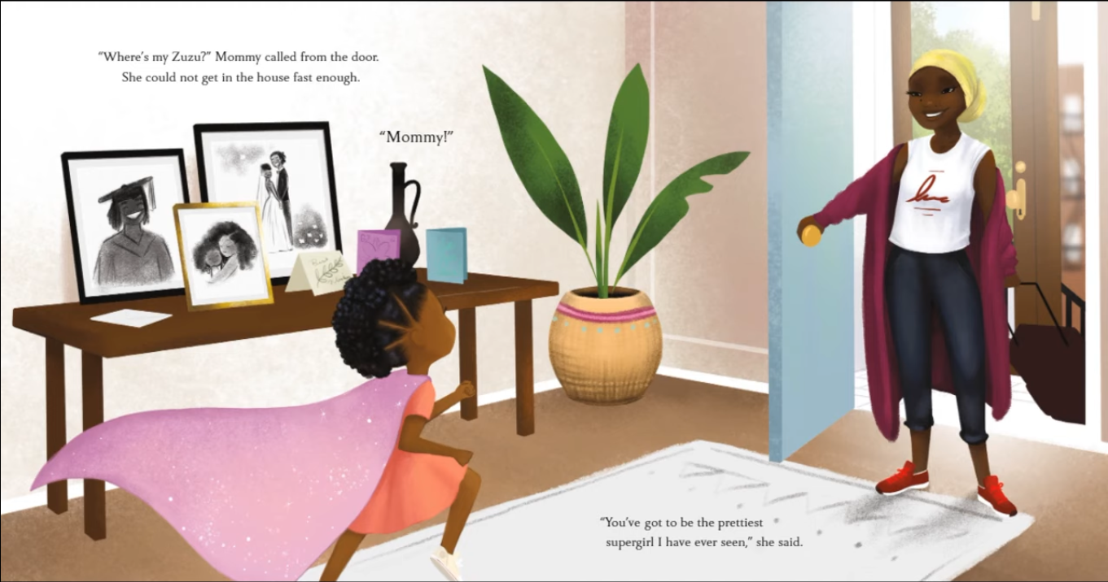
25 Mommy came home and Zuri showed her her hair. 26

Slide 15
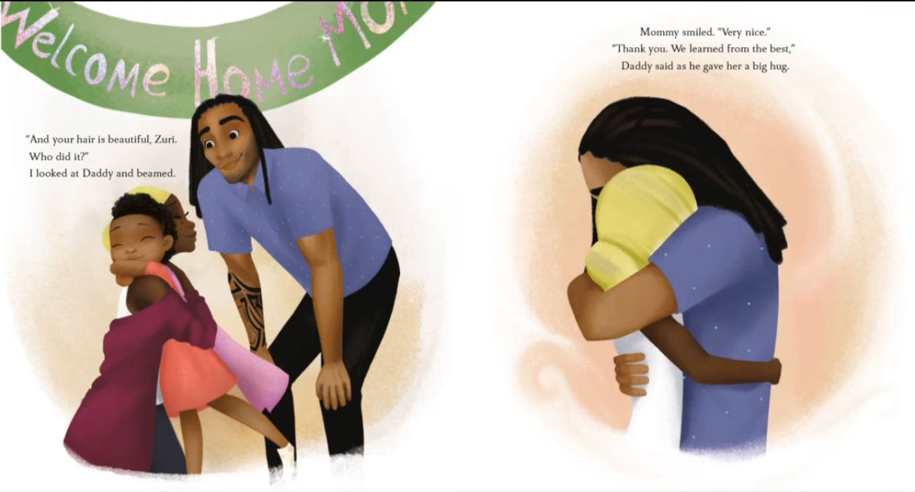
27 Zuri and Daddy welcomed mommy home with big hugs. 28

Slide 16
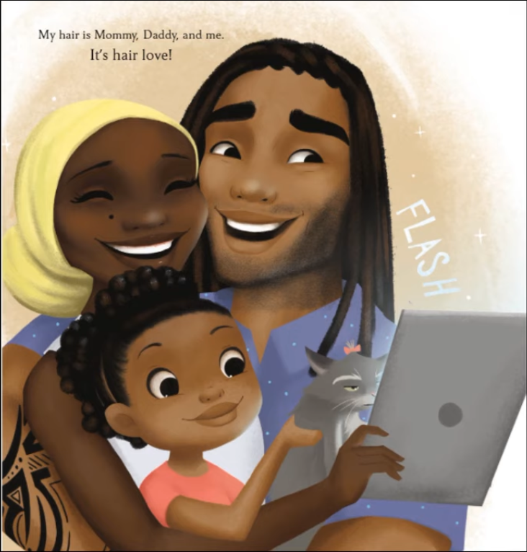
29 Zuri took a picture with her family.

